Slide 1
Sales Accelerator:
Emircom MANAGED CISCO SD-WAN SERVICE
Why should you care?
The ability to bring office experiences to the remote workforce with reliable and secure connectivity across cloud and applications is a critical success factor in the hybrid work environment.
70% of CIOs anticipate redefining what productivity looks like compared to how they defined it pre-pandemic.
77% of employees will embrace a flexible workstyle.
98% of all meetings will have at least one remote participant.
Managed SD-WAN market will grow from $590M in 2022 to $3.8B in 2033
90.2% of Enterprises have an SD-WAN Strategy
58% faster to implement policy and configuration changes
Solution overview
Managed SD-WAN with Emircom and Cisco is flexible and feature-rich, providing secure segmentation, advanced routing, and exceptional support for single and multitenant deployment, with a wide range of deliverables..
Connect any user to any application, at any time, on premise. Or in any cloud.
Emircom Managed SD-WAN offers businesses the capability to fully outsource WAN requirements, including outsourcing of the WAN edge, virtualization, overlay of WAN & security policies, WAN optimization, configuration across branch-office and remote users, adds/moves/changes, underlay, project management with ongoing 24/7 support, and network performance monitoring.
Managed SD-WAN technology will either include hardware in the form of managed customer premise equipment (CPE) or virtualized instances. The managed or virtual CPE is fully configured and managed by Emirocm and provides network connectivity as well as bandwidth control and path optimization.
Emircom Managed Services to maximize your agility, application control, and efficiency while maintaining your internal staff’s focus on strategic business outcomes.
Common challenges
Traditional WAN architectures can’t handle the demands of multicloud adoption.
Networking teams have difficulty enabling hybrid work and ensuring quality experiences for remote users.
IT teams lack the tools and real-time insight to deliver optimized performance and automation
Network teams are being tasked with enabling digital transformation, hybrid work, and the multicloud and don’t have the cycles to focus on day-to-day network management and operations
Top use cases
Scalable solution for hybrid workforces
Secure collaboration
Reliable remote SD-WAN connectivity
Enhanced visibility
End-to-end policy compliance
Centralized management with automation
Across-the-Board Benefits
Give branch offices more connectivity (increase bandwidth by up to 20x
Leverage built-in advanced security functions.
Simplify management with application-aware features. .
MPLS-like performance and security with internet-like flexibility
Augment or replace premium WAN bandwidth
Reduce costs and lower operational complexity and provide a high-quality experience
Scale the network with provisioning in minutes, not days

Slide 2




Questions to ask per Persona
CIO
Are you being asked to support a growing number of hybrid work use cases?
What potential difficulties are you encountering as you migrate to the cloud?
Overall, how would you rate your employees’ remote experiences?
How are you enabling secure and multichannel collaboration capabilities across your campus and branch workspaces, and employee homes?
Has your technology landscape become easier or more difficult to manage with the drive to SaaS and IaaS?
Line-of-business leader
What benefits or challenges have you experienced as a result of a more distributed workforce?
Are you exploring opportunities to improve or provide new ways for your customers to interact with your distributed workforce?
How are the expectations of new employees shaping the way your company operates?
IT leader
What steps have you taken to modernize your IT operations from reactive and siloed to proactive and predictive?
Have application and network performance insights proved difficult with the move to SaaS and IaaS?
CISO
How are you securing your remote or hybrid workforce who are accessing data?
As employees move between working on campus and working remotely, what are the challenges you see in securing data on mobile devices?
Simplified IT, your way
Cisco
SD-WAN
Any deployment
On-premises | Cloud | Multitenant
Automation | Network | Insights | Analytics
Open | Programmable | Scalable
Any transport
Satellite
Internet
5G/LTE
MPLS
Branch
Cloud
Any location
Remote Users
Colocation
Emircom-managed
Connect
Secure
Optimize
Competitive Differentiator
Transport Independence: Leverage bandwidth across various transport options while maintaining security and quality of service (QoS).
Flexibility: Enable both cloud-based and on-premises deployments
Path Control: Improve agility, resilience, and bandwidth efficiency by leveraging multiple WAN paths.
Application Optimization: Enhance user experience with intelligent performance optimization, especially for SaaS platforms.
Scalability: Lower infrastructure investments and minimize manual provisioning .
Zero-touch Deployment: Reduce deployment times by remotely defining and provisioning new equipment and services at scale.
Automation & Orchestration: Improve IT productivity and reduce costs with cloud-based management, service orchestration, and visibility.
Cost Optimization: by utilizing all links with path optimization capabilities
Security: Integrate with SASE platforms for a full suite of security services, such as secure web gateways (SWGs), cloud access security broker (CASB), and data loss prevention (DLP).
Cloud Connectivity: Simplify and accelerate adoption of cloud computing technology with direct cloud networking connectivity options and SASE implementations.

Slide 3

2023
Cisco Best SD-WAN Platform - CXO Security innovation Awards
  Discovery questions
  What strategies are you using to optimize workflows, reduce network complexity, and scale for growth?
  Tell me about the user experience of your hybrid workforce. Are they able to connect seamlessly? Collaborate and share data and documents securely?
  How are you achieving network visibility from your users to the cloud?
  How do you currently ensure consistent network uptime and availability?
  How do you secure and seamlessly work within your network—users, data, and apps—on-prem and among brand/other locations?
  Are you confident in the level of application usage visibility you have across your organization?
  What security measures do you have in place and how do you continuously assess and evolve your security footprint?
  Do you have network experts who optimize your network experience? Are you able to consolidate billing or use other tactics to create a predictable OPEX?
  How do you fill skills gaps within your IT department?
  How much IT staff time is spent on ‘keeping the lights on’ versus focusing on strategic initiatives?
  Describe how you simplify administration, improve application-level visibility, augment appliances with virtualization, automate connection failover, and use policies to automate minor and major tasks.
2022
Leader in WAN Edge
Magic Quadrant
2021
Best Security
Company
SC Media
2021
Cloud Computing
Product of the Year
ThousandEyes
2021
CRN Tech Innovators
Cisco Catalyst 8000
2020
Zero-Trust
eXtended Ecosystem
Forrester Wave
2020
CRN Tech Innovators
SASE
  Objection handling
No budget | I understand. Budgets are a tough one. However, what if you made a change this year that not only freed up some CAPEX, but could also lower your 5-year WAN cost by 38%? How soon would you like to see that 38% savings?
Timing not right Not ready to decide | I understand—there are a lot of priorities competing for your time. However, were you aware that 68% of security breaches can be attributed to branch offices and remote users? Where is security among your priorities?
Decided on a different direction | Glad to hear you’re considering a change. I’d like to hear more about your decision.
Don’t have the staff | I understand. Everyone is really stretched. However, a managed SD-WAN can free up resources. But what if your team could implement policy and configurations changes, and onboard new services 58% faster? That’s just a small slice of the efficiencies you could gain—giving your team more time to tackle new, strategic initiatives.
Emircom LLC Confidential. Internal Use Only. All Rights Reserved 2023

Slide 4
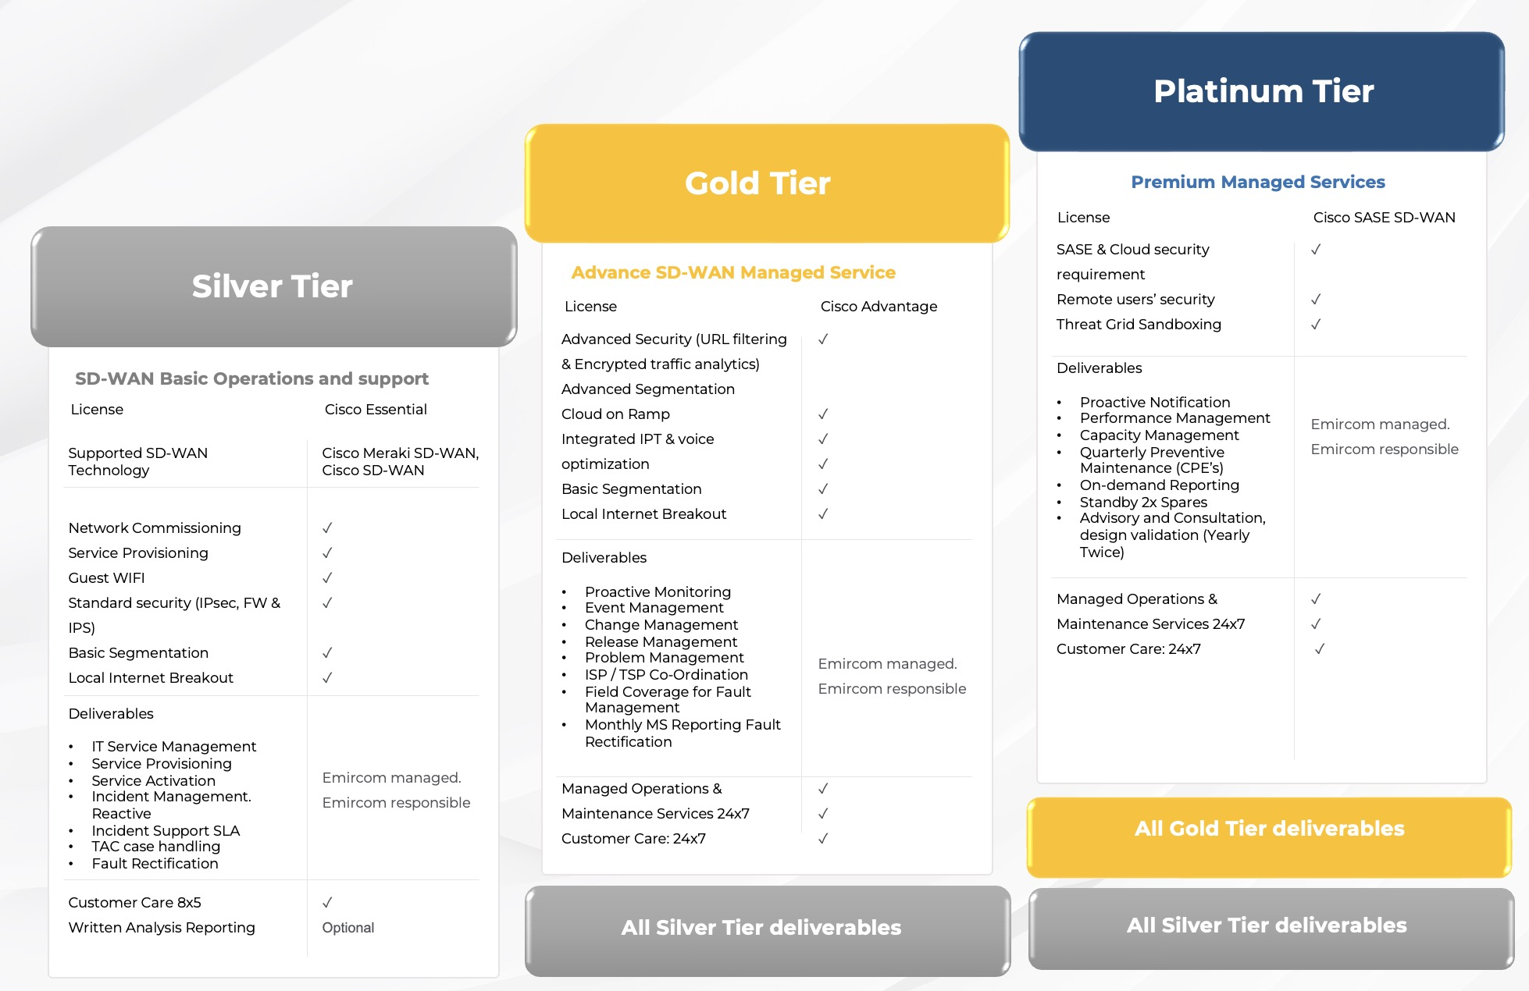


61M
  Emircom Managed SD-WAN Offering
endpoints protected
80%
of the internet
traffic through
Cisco’s infrastructure
#1
in SD-WAN
market share
70%
Fortune 100
deployed
840K+
networks protected
46K+
WAN Edge
customers
Emircom LLC Confidential. Internal Use Only. All Rights Reserved 2023

